Slide 1

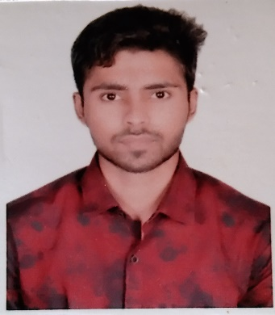


Vaibhav Kamthan
Education and certificates
Bachelor of Engineering Computer Science : 2015 - 2019
Analyst/Software Engineer
Skills Spring Boot Spring MVC
Core Java
MongoDB
React js
Salesforce
Base Location: Mumbai
Email ID:
Vaibhav.kamthan@capgemini.com
_{Mobile No: 8839016174}
A4
Grade:
Backend
Spring Boot/Spring Security
REST-API
Strengths
A self driven learner with Front-End and Back-End knowledge. Passionate about implementing and launching new projects.
Ready to learn new technologies/Frameworks and implement them to further improve my knowledge.
A team player with good communication skill always ready to work for the enrichment of knowledge.
Has working knowledge on React js and Java Microservice Development using Spring framework on an intermediate level.
Achievement
Bench Tracking App
Completed end to end case study of Bench Tracking App along with JWT authentication using Spring boot Microservices with Eureka Server. React js used for user interface. Junit and Mockito for testing.
Database
SQL database – MySQL
No SQL database – MongoDB
Coded and designed Single page web application
Web Technologies
HTML5 CSS3
Javascript/TypeScript
Developed website with React js, HTML5 and CSS3 to make website more interactive and dynamic.
AddOns Github Maven Postman
Also Implemented Eureka Server and API Gateway in case study and upskilling day by day.
Additional Details
Excellent Communication Skills
Team Player
Check out my work on GitHub & Video Profile
Presentation Title | Author | Date © Capgemini 2017. All rights reserved | 1

